Slide 1
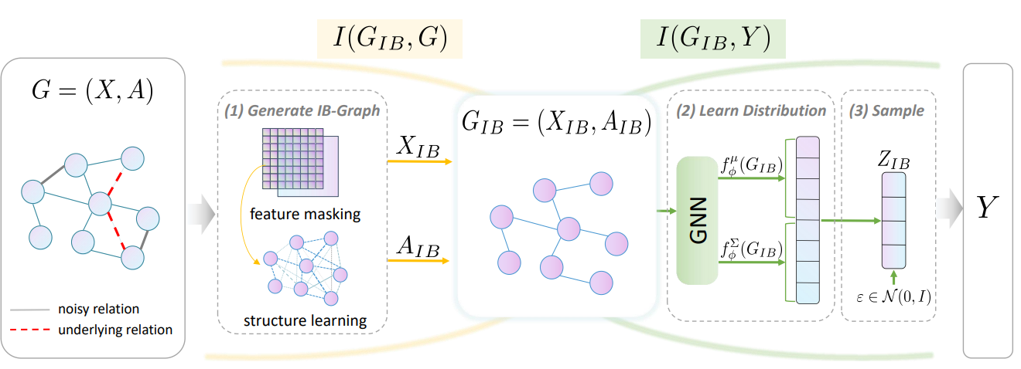
Graph Structure Learning with Variational Information Bottleneck
Lee deok joong
AAAI 2022

Slide 2
목차
01
Introduction
02
Background and Problem Formulation
03
Variational Information Bottleneck Guided Graph Structure Learning
04
Experiments
05
Conclusion

Slide 3
01
Introduction

Slide 4
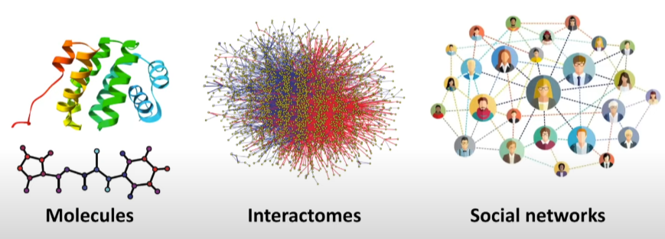
01 Introduction
Recent years have seen a significant growing amount of interest in graph representation learning. Ex) drug design, social networks, traffic networks, physics, combinatorial optimization, medical diagnosis
However, these raw graphs are naturally admitted from network-structure data or constructed from the original feature space by some pre-defined rules, which are usually independent of the downstream tasks and lead to the gap between the raw graph and the optimal graph for specific tasks.
Moreover, most of graphs in the real-word are noisy or incomplete due to the error-prone data collection, which could even exacerbate the quality of representations produced by GNNs.
https://www.youtube.com/watch?v=LeeUzusWz5g

Slide 5
02
Background and Problem Formulation

Slide 6
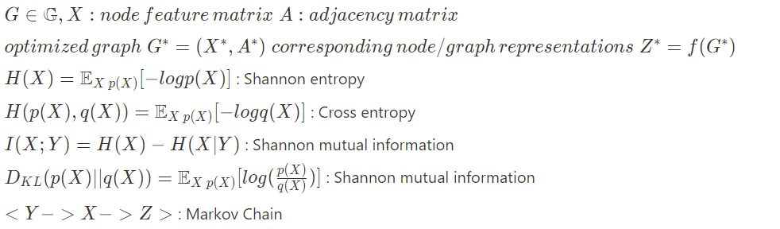

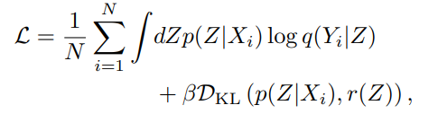
02 Background and Problem Formulation
Graph Structure Learning & Information Theory
Information bottleneck
Deep VIB (Alemi et al. 2016)
Notes:
VAE에서 했던 과정에서 minimiz로 바꾸고 그걸 graph neural networ에 적용한것..

Slide 7
03
Variational Information Bottleneck Guided Graph Structure Learning

Slide 8
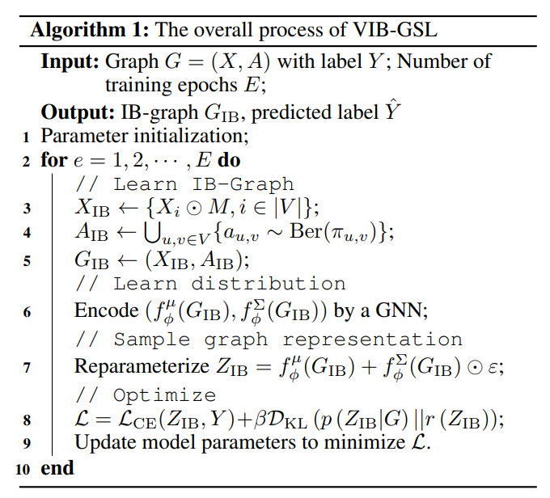
03 Variational Information Bottleneck Guided Graph Structure Learning
VIB-GSL Framework
Algorithm

Slide 9
04
Experiments
Notes:
정말 가볍게만 정리 -> 질문 들어오면 notion정리된거 뽑아둔걸로 확인

Slide 10
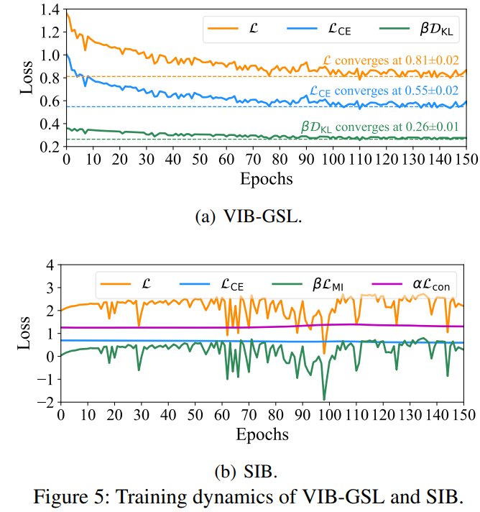
04 Experiments
Training Stablility
SIB는 MINE기반의 bilevel optimization 때문에 MI loss가 굉장히 수렴이 힘들고, unstable한 결과를 보여줌
VIB-GSL은 stable하고 수렴이 잘 됨을 보여줌 ➔ 효율적이고 안정된 학습이 가능하다.
Notes:
figure를 보면 알겠지만, SIB같은 경우 MI loss가 굉장히 불안정하고 connectivity loss는 거의 변화가 없는걸 볼 수 있다.
⇒ MINE기반의 bilevel optimization[inner loop필요]는 학습적으로 비효율적이고 unstable한 process를 보여줌
하지만, 그와 달리 VIB-GSL은 converge가 잘 되는것을 볼 수 있었다!

Slide 11
05
Conclusion

Slide 12
05 Conclusion
In this paper, we advance the Information Bottleneck principle for graph structure learning and propose a framework named VIB-GSL, which jointly optimizes the graph structure and graph representations.
VIB-GSL deduces a variational approximation to form a tractable IB objective function that facilitates training stability and efficiency.
We evaluate the proposed VIB-GSL in graph classification and graph denoising. Experimental results verify the superior effectiveness and robustness of VIB-GSL.
Notes:
이 논문은 IB principle을 이용한 Graph structure learning을 시도했고, graph structure와 representation을 jointly하게 opimize하였다.
그리고 tractable한 variational approximation으로 효율적인 학습을 보장해줌.
SIB와 달리 stable하고 쉽고, efficiently한 학습 과정을 보여줌

